Slide 1
Drawing Class #3!
Presented by Karen Kliethermes

Slide 2
Professor Raj’s Next Assignment - Brainstorming Session!
Basic project guidelines:
Must be a drawing with text
Subject is open--could be anything!
Vision of either the past or present
Prof. Raj wants you to have an idea in mind this week for this future assignment
Open Discussion - what are your ideas for this project? What comes to mind?

Slide 3
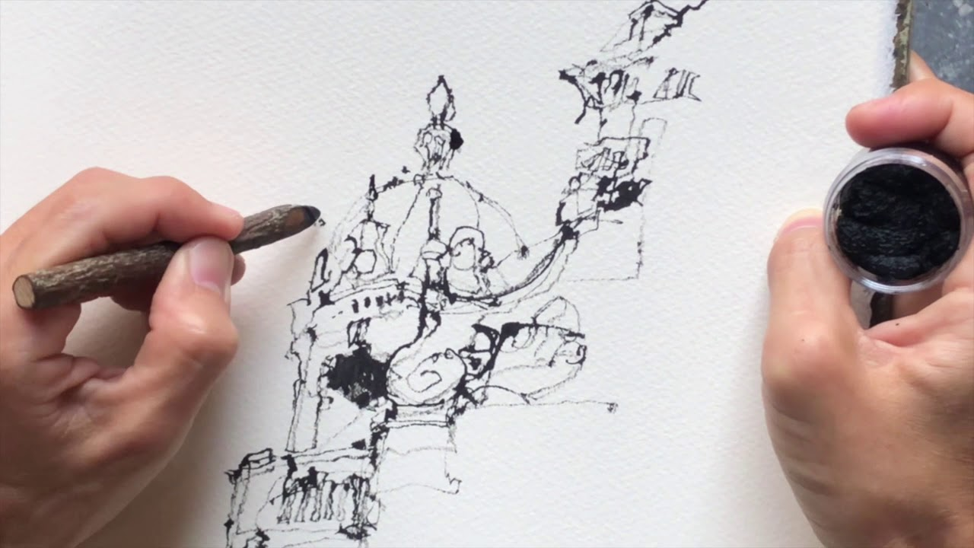
Today’s Goals:
Strengthen previously learned drawing skills
Expand drawing skills - using ink and bamboo sticks!
Apply drawing skills to a less tangible goal
Test your creativity and problem-solving skills!

Slide 4
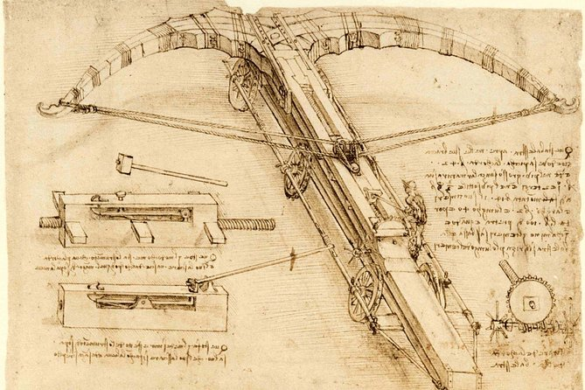
Design an invention!
What could improve the world/existence as we know it?
Could be anything! Big vs small, serious vs silly, etc.
Create schematic that uses a visual and words to show how it works
Make it nice--you’re going to be sharing it with class! ;)

Slide 5
Your schematic must include:
Name of invention
Straight-forward drawing of invention
1-3 descriptive sentences, describing why this invention is important
At least 2 arrows pointing to parts of invention, with short descriptors of how the parts work

Slide 6
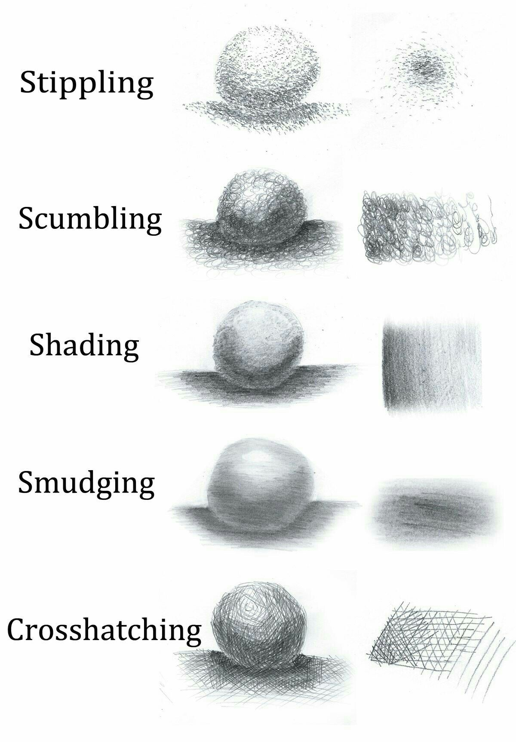
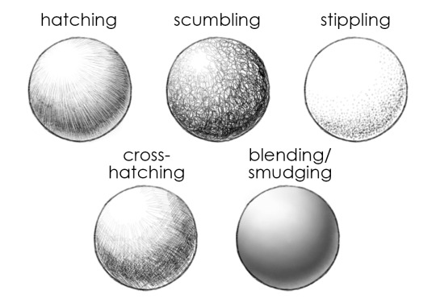
Shading Techniques

Slide 7
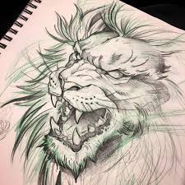
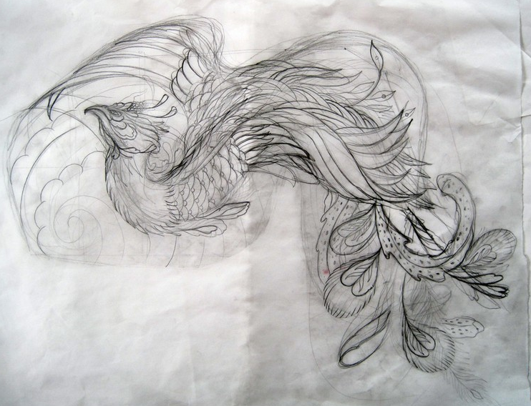
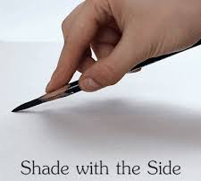
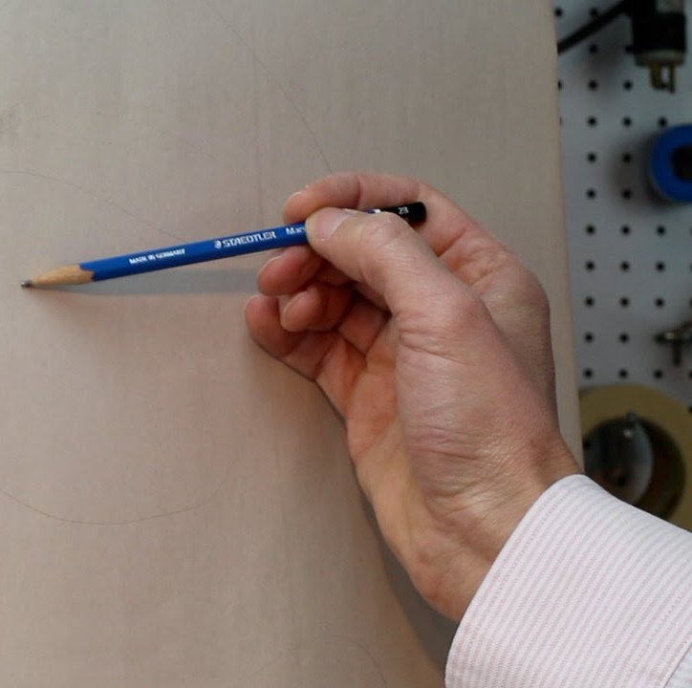
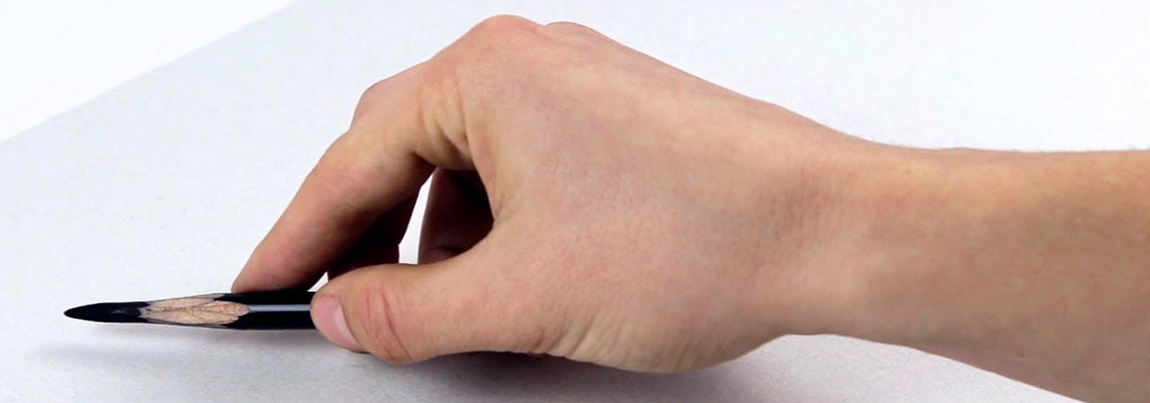
Sketching Tips
Hold pencil loosely in hand, press lightly
Don’t be afraid to be incorrect; draw lightly until it’s correct
When lines are proportional, darken them slightly
Can use one light color for sketching first, and a darker color for dark lines after
Notes:
I think of tattoo artists when they sketch
Sometimes they use multiple colors to sketch, with the initial color being light and the final color being darker

Slide 8
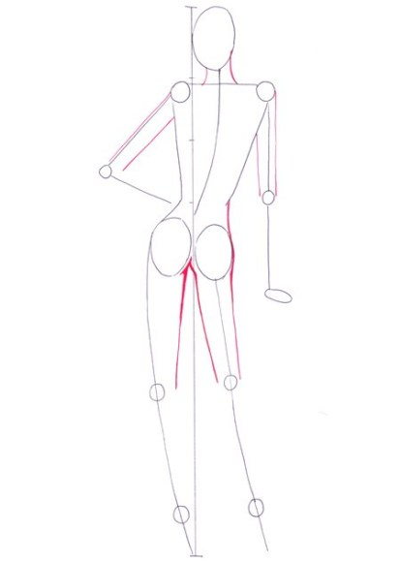
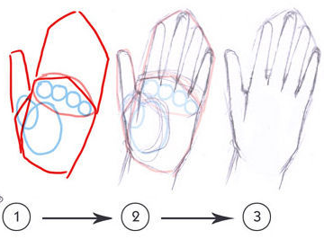
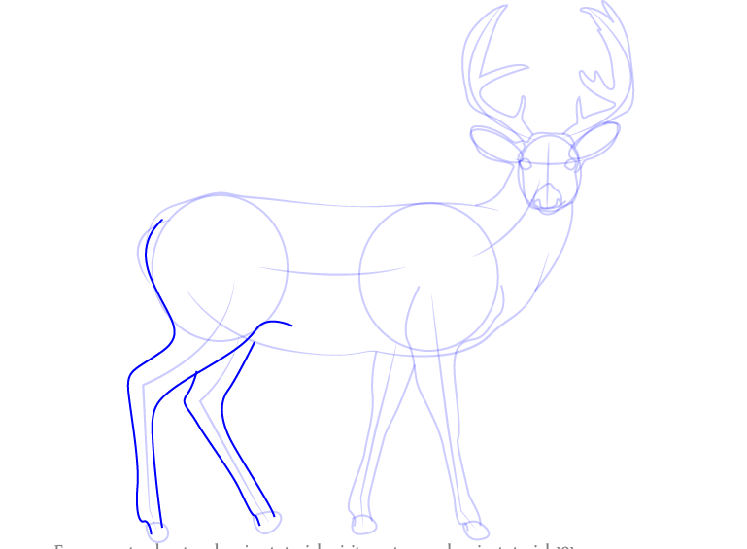
Form
Start outline by using basic shapes
Refine the basic shapes with more detail and intricate lines and curves
Double-check your proportion
Erase gestural lines (if necessary)

Slide 9
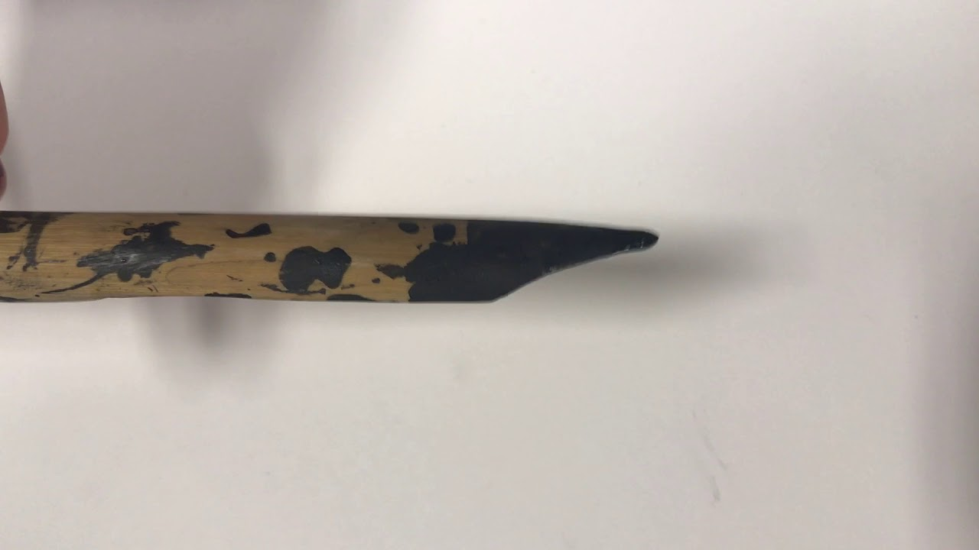
Today’s Ink Tips:
Pretty straightforward--dip bamboo stick in ink, and continually dip it as it runs out (bamboo absorbs the ink, makes for decent utensil!)
Use tip of bamboo stick for finer detail, hold at an angle on the bamboo’s side to get wider lines
Hold ink firmly in non-dominant hand, so it doesn’t spill!
Be careful not to get on clothes--it will stain! If you do, rinse immediately

Slide 10
Drawing steps!
In pencil, gesture drawing of invention
In pencil, line drawing of invention
With ink and bamboo stick, (raise your hand when ready for this step to receive supplies!), draw over pencil lines to make finalized drawing
Write title, descriptor points, and sentences

Slide 11
Your schematic must include:
Name of invention
Straight-forward drawing of invention
1-3 descriptive sentences, describing why this invention is important
At least 2 arrows pointing to parts of invention, with short descriptors of how the parts work
Drawing steps!
In pencil, gesture drawing of invention
In pencil, line drawing of invention
With ink and bamboo stick, (raise your hand when ready for this step to receive supplies!), draw over pencil lines to make finalized drawing
Write title, descriptor points, and sentences

Slide 12
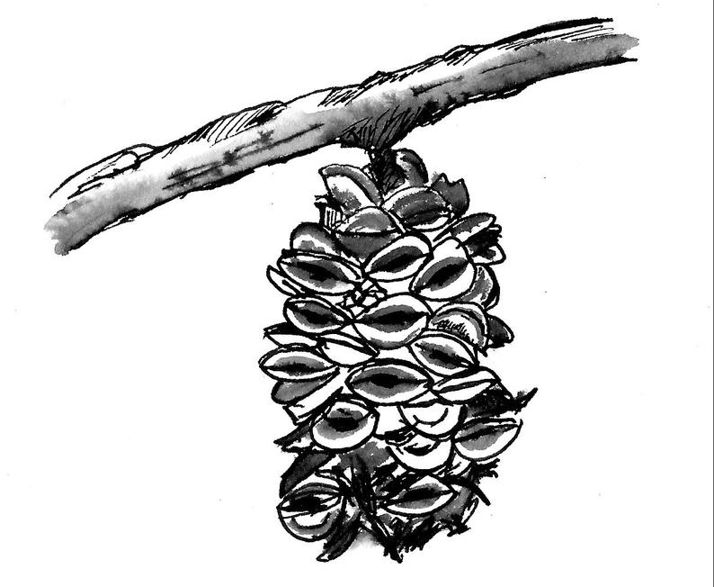
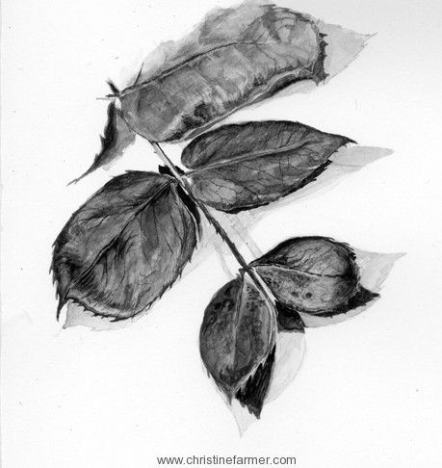
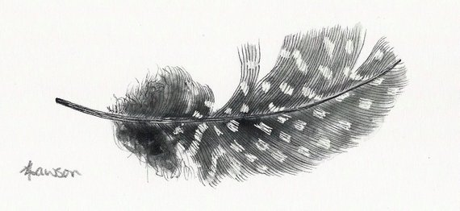
For Next Class:
Please bring a nature object that you want to draw!
Could be a cool stone, pinecone, leaves, flower, feather, fallen bark, etc.
We will be using ink and brushes to develop values--ink washes using water ratios
See you Wednesday! :)

